Slide 1
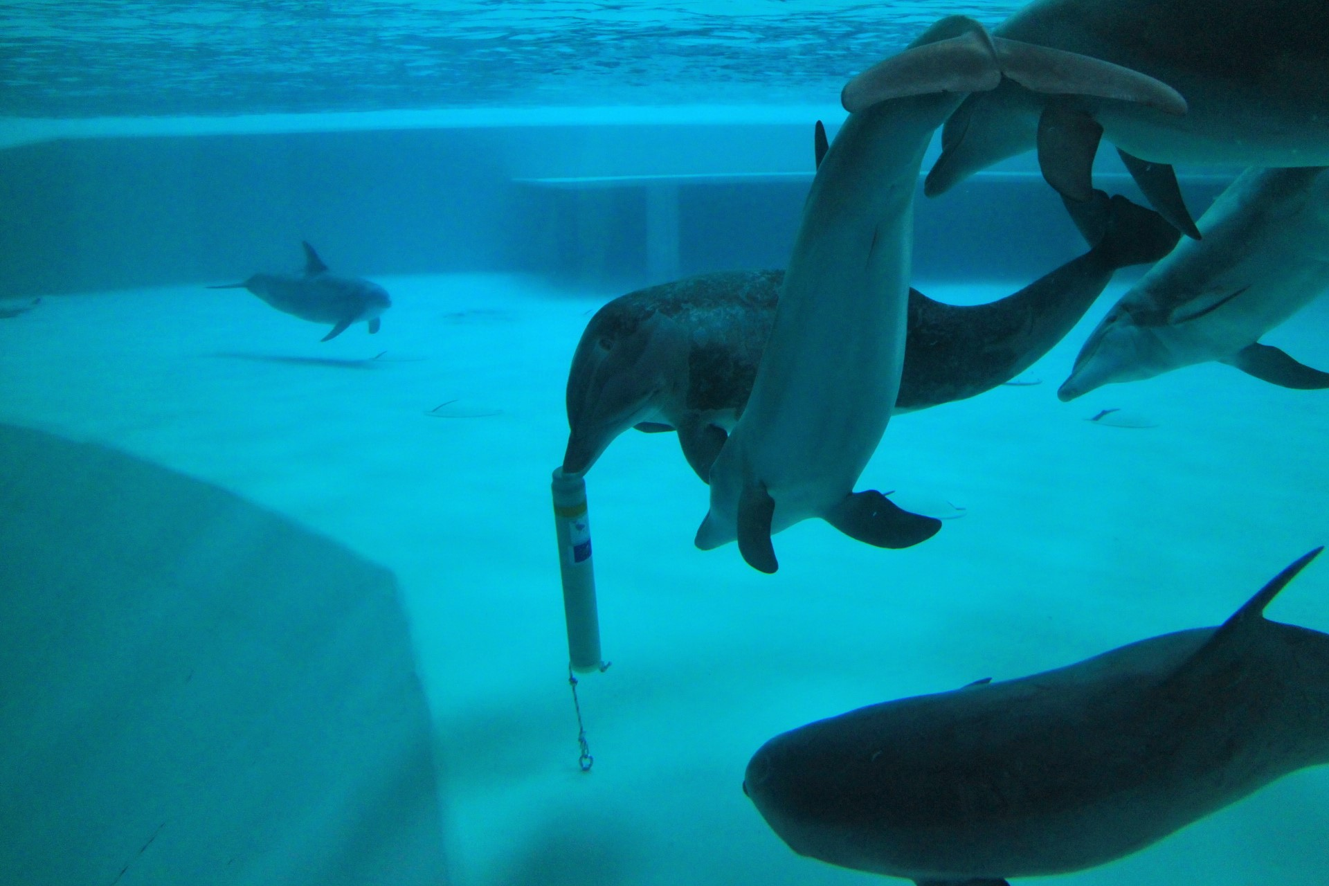
The importance of acoustic enrichment for bottlenose dolphins (Tursiops truncatus) in human care.
By: Laura van Zonneveld Supervisor: Mats Amundin

Slide 2
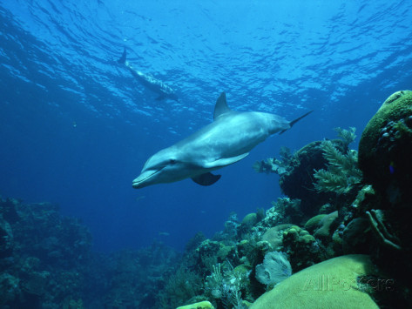
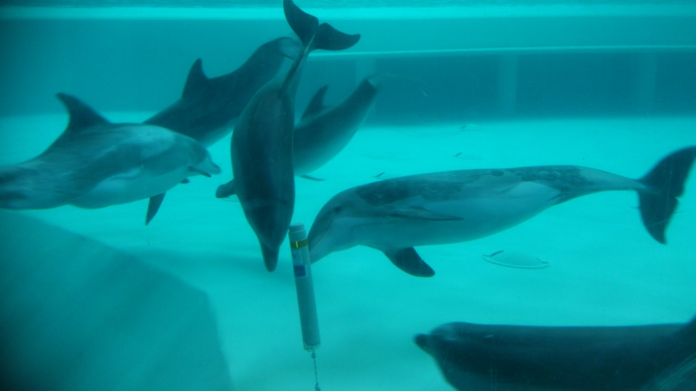
Aim of the study
Barren environment due to hygiene measures
Under stimulating for an curious echolocating species
Will underwater structures be a useful acoustic enrichment, and possibly be used as landmarks?
Notes:
The aim of this study can be best explained by comparing these two pictures. On the left the dolphins in Kolmården, and on the right a dolphin in a natural environment. As you may see, the pool environment is very bare, with almost no structures for the dolphins to explore due to hygiene measures. For an curious echolocating species this environment can be quite under stimulating. So during this study, we provided the dolphins with underwater structures and studied how these structures are used and if they could thus be a good acoustic enrichment to their environment, and even possibly be used by the dolphins as a landmark for orientation around the pool.

Slide 3
Materials and methods

Slide 4
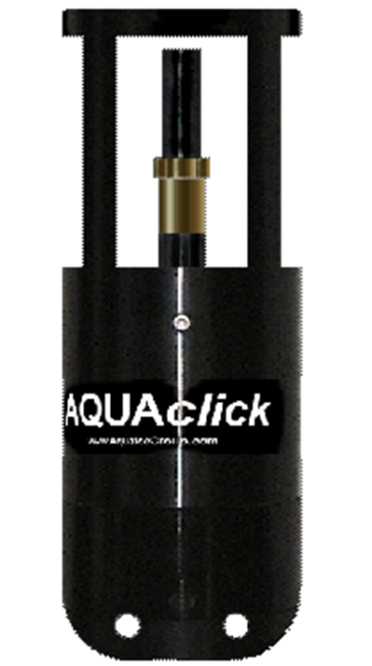
10 CPODs and 2 PCLs
Record echolocation clicks.
Data was extracted once a week
Notes:
The most important part of the study were the CPODs and PCLs. These devices are used in porpoise and wild dolphin reseach. They record echolocation clicks, and this data we extracted once a week. These devices were used as our underwater structures.

Slide 5
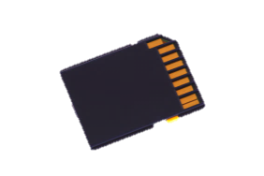
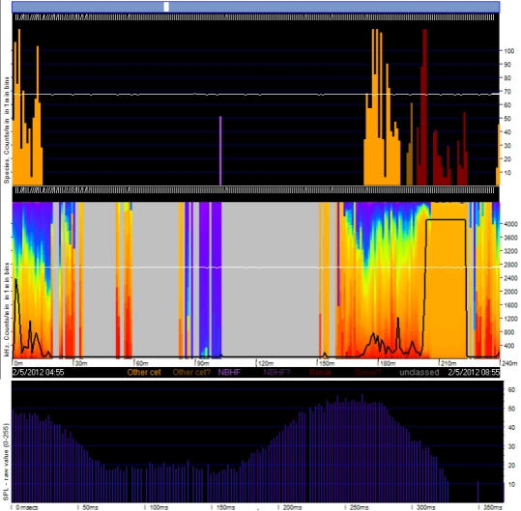
Data collection from the CPODs
Notes:
The CPODs are filled with batteries, a hydrofoon, sdcard and air. The air inside gives a strong echo when hit by the dolphins sonar clicks. The recorded clicks are recorded on a Sdcard. The recordings can be analysed by special software, where click trains can be made visible.
In this slide a sound recording can be found!!

Slide 6
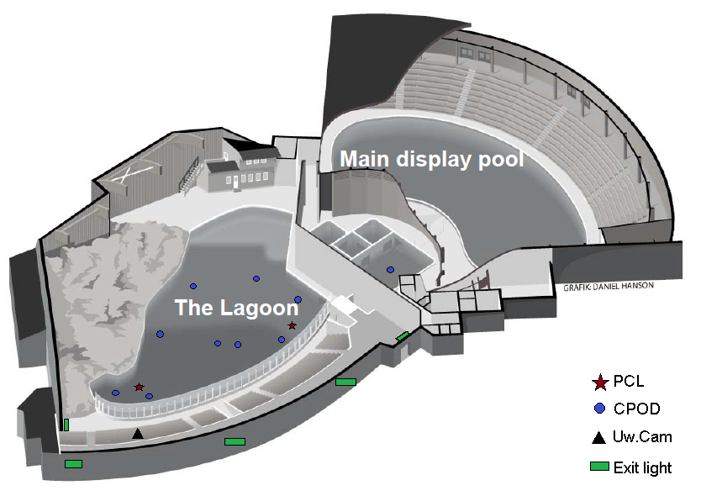
Attachment procedure
Notes:
We attached all the devices to the pool floor of the laguna, and one on the pool floor in the holding pool. We attached them to the bottom off the pool, suspending about 40 cm above the pool floor into the water column. The CPODs and PCLs are taken out of the water about once a week, the recorded data will then be uploaded to our pcs, and empty Sdcards are placed back again.

Slide 7
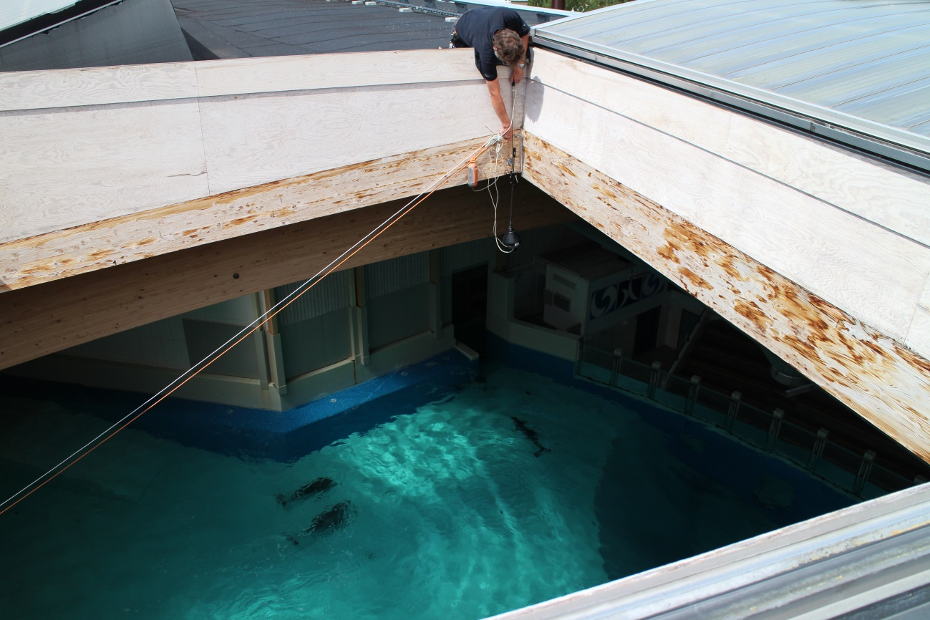
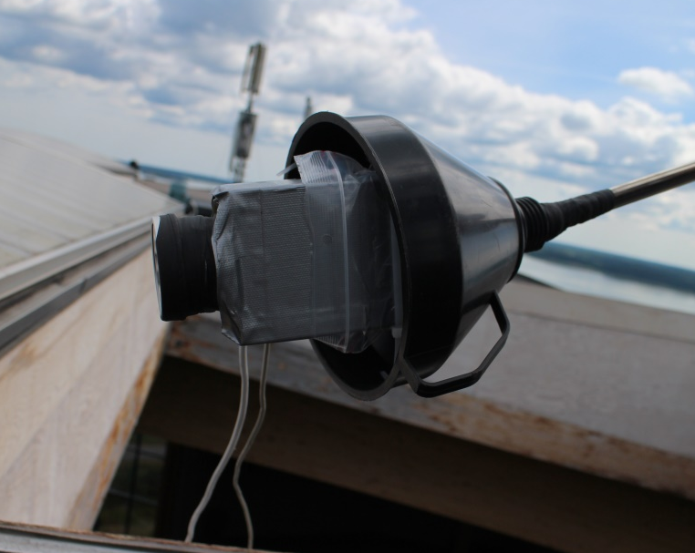
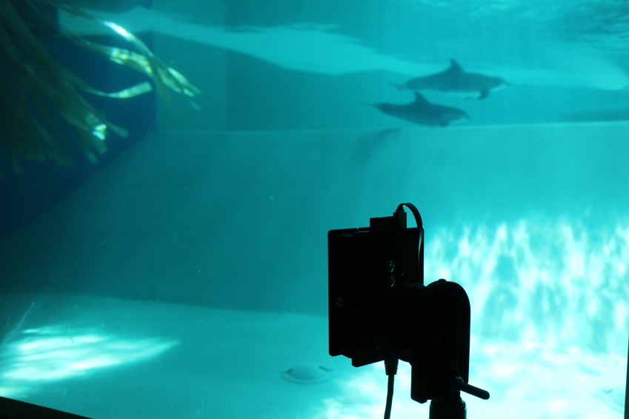
Materials
2 cameras
Continuous recording for 12 hours a day, for a total of 5 months.
Notes:
How are we studying this? It all started with the setting up of 2 cameras. One is attached on the roof and overlooks almost the entire Laguna pool, recording the swimming patterns of the dolphins. The other camera is located behind a window under the water surface. This camera records the interactions of the dolphins with the cpods.

Slide 8
Results and Discussion

Slide 9
Interest in novel object results
Behaviour recordings
Investigative and play behaviours decreased over one week time.
Echolocation click recordings
The number of logged clicks dropped significantly over 3 weeks after which it leveled at an average of around 5000 clicks/hour per day and logger.
Notes:
The first thing we researched were the behaviour recordings displayed towards the devices, because we were interested in when the novelty of the devices wears off. Unfortunately the CPOD data could not be used due to technical problems. So instead I recorded the behaviours for the first 3 weeks and found that investigative and play behaviours decline significantly over 1 week time, and were only occasionally present after 3 weeks. Several weeks later we started using the PCLs, or which we could use the recordings. Luckily, the PCLs have a different look (will be explained later) which made the dolphins very interested, so novelty behaviours were regained and the decline could be analysed through the echolocation recordings as well. In total a significant decline over 3 weeks was found. And in this graph the decline is visualized. The graph shows the first week after the PCLs were attached. During the first day an average of 20.000 clicks were recorded per hour, and this declined and leveled at 5000 clicks on average recorded per hour, which was found in the rest of the study period as well.

Slide 10
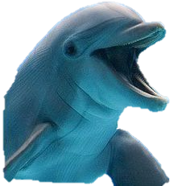
Regaining novelty behaviours
Wow! Such change!
Notes:
So why were the dolphins so interested in the PCL after having the CPODs for several weeks? Well, as I mentioned before, the CPOD is air filled and floats by itself. But the PCL does not float by itself, so to keep it suspended from the pool floor, we attached 2 floating devices. This different look interested the dolphins a lot and they investigated them extensively after they first arrived. So to us, they look very similar, but the dolphins loved them.

Slide 11
Echolocation diel patterns results
More clicks were recorded between midnight and early morning.
Dolphins seem to rest after 6pm to midnight, during which echolocation is only occasionally used.
Season and daylight hours do not seem to influence this diel pattern.
Similar pattern seen in wild species, who mainly forage at night.
Notes:
A very clear diel pattern was found in the echolocation recordings. To our surprise the dolphins echolocate a lot after midnight, and this activity stays high during the morning, after which it declines and reaches its lowest point in the evening, after staff leaves. The dolphins seem to rest after 6pm, during which they are very quiet and not much echolocation is used. Since the study period was quite long, we were able to compare seasons. But time of sunset and sunrise did not seem to influence this diel pattern, and interestingly a similar pattern is seen in wild species who use the night time to forage.

Slide 12
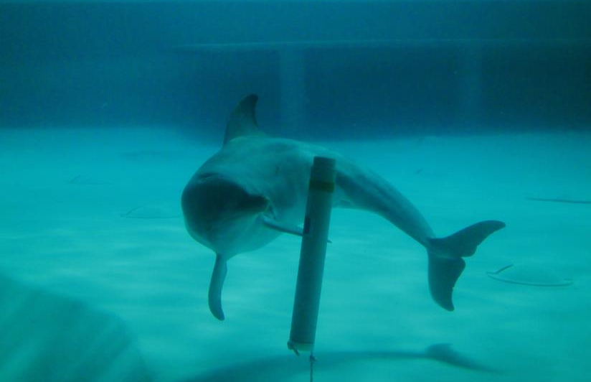
Click-train analysis results
4 types of click-trains were analysed
Behaviours displayed during the recordings were:
Exploratory
Play
Quick investigation whilst swimming past
Notes:
When I analysed particular click-trains, I focussed on 4 types of click trains. I found that the behaviours displayed during these recordings were mainly exploratory or play, and small, short click trains were recorded when the dolphins would swim past the device and quickly point the snout towards it.

Slide 13
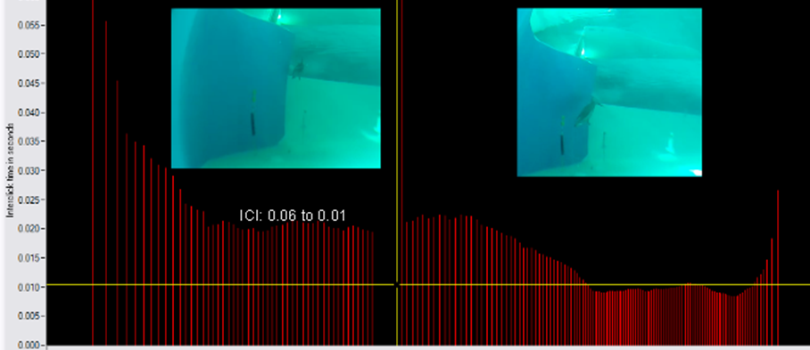
Click-train: approach
4 types of click-trains were found, where ICI (interclick interval) was mainly focussed on.
Most locked on click-trains were recorded during investigative and play behaviours.
The highest possibility of dolphins using the devices as landmarks (more than 1800 clicks per hour) was recorded in the morning (6am-12pm).
During rest very low amounts of clicks are recorded.
Notes:
This is an example of one of those type click-trains. This is a decreasing type which is also seen in other echolocating species, also in bats. What you see in the picture is the ICI (interclick interval) which is the time between each emitted click. During approach the ICI becomes shorter, and the final stage is characterized by a buzz, this is very typical also when an echolocating species approaches and catches a prey.

Slide 14
Click-train: play
Notes:
This is a typical click-train seen during play, very short ICI, also referred to as a buzz. The dolphin is pushing the device down whilst echolocating after which it moves away.

Slide 15
Landmark use frequency
During rest, the dolphins are very quiet.
For long periods of time the dolphins did not use the PCL as a landmark but manage to navigate past them, most likely by using visual cues, or relying on each other.
Even after sunset landmark use is low, but exit lights might provide enough light to orientate with.
Notes:
We also investigated how often they would possibly use the devices for orientation. So videos were used of the dolphins in rest. During rest they typically swim in a circular pattern in small groups. Some locked on click-trains were found during rest, but very few and small. For very long periods of time the dolphins would be passing the devices repeatedly but no clicks were recorded. Vision seems most important for orientation, and since they swim close to each other, they might rely on each other as well. But even after sunset echolocation stayed low, and the most likely explanation for this is that the exit lights located around the pool might provide them with enough light to navigate with.

Slide 16
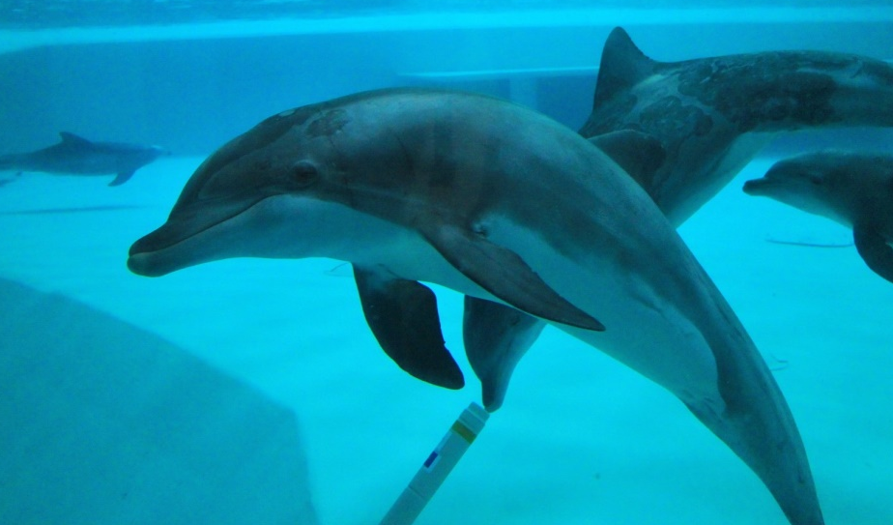
Possible landmark use
During night time and morning the possibility that landmarks are used is highest.
However, this landmark use is also masked by echolocation used for different purposes such as communication and play.
Notes:
When we looked at which times of day the dolphins most possibly make use of landmarks we found that during night and morning this is the most possibly since they admit the most clicks during those times. However, these recordings are also masked by echolocation used for different purposes such as play, investigation and communication.

Slide 17
Conclusion
And???

Slide 18
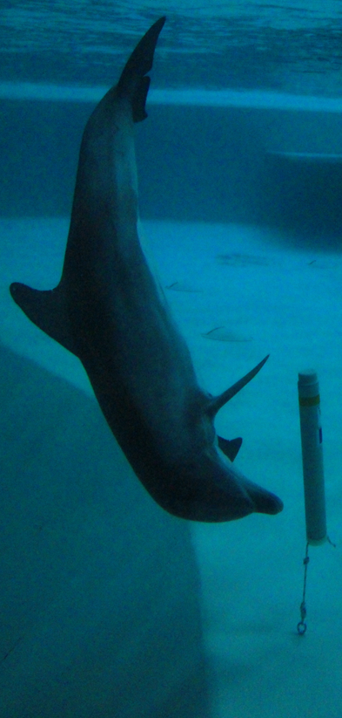
Main conclusions
Dolphins echolocate most after midnight and during early morning.
During rest, possible use of landmarks is low. Vision might be more important for orientation.
Play and investigative behaviours decline quick.
Novelty can be regained when look and acoustic target is changed.
Notes:
So our main conclusions…

Slide 19
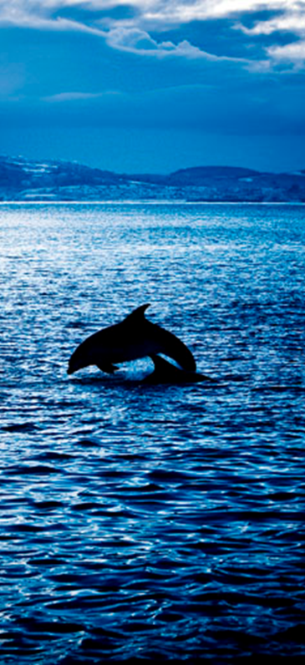
Other findings
Season does not seem to have an effect on the diel patterns.
More time was spent and more clicks were recorded in the deeper area of the pool.
During rest the dolphins mainly swim in a clockwise circular pattern in close contact with each other.
Notes:
Some other findings…

Slide 20
How is this information useful?
Underwater structures encourage investigative and play behaviours and are possibly used as landmarks.
Trainers are now experimenting with different underwater structures, to encourage echolocation use.
Notes:
And… We did find that the devices encourage the use of echolocation, through play, investigative behaviours and as a use of landmark, mostly when the object is still novel. The trainers have been making some underwater structures for the dolphins which give off a strong echo and would change the look and location of the devices every so often to keep the dolphins interested.

Slide 21
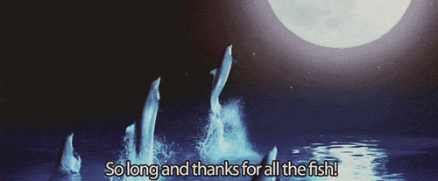
So long! And thank you for your attention!
Acknowledgement: Mats Amundin, Stina Karlsson, Johannes Höök, Wouter de Witte and the other trainers. Daniel Wennerberg, Niclas Lundström, other Kolmården staff and Sandra Nicklasson.
Notes:
Tadaah!!

