Slide 1
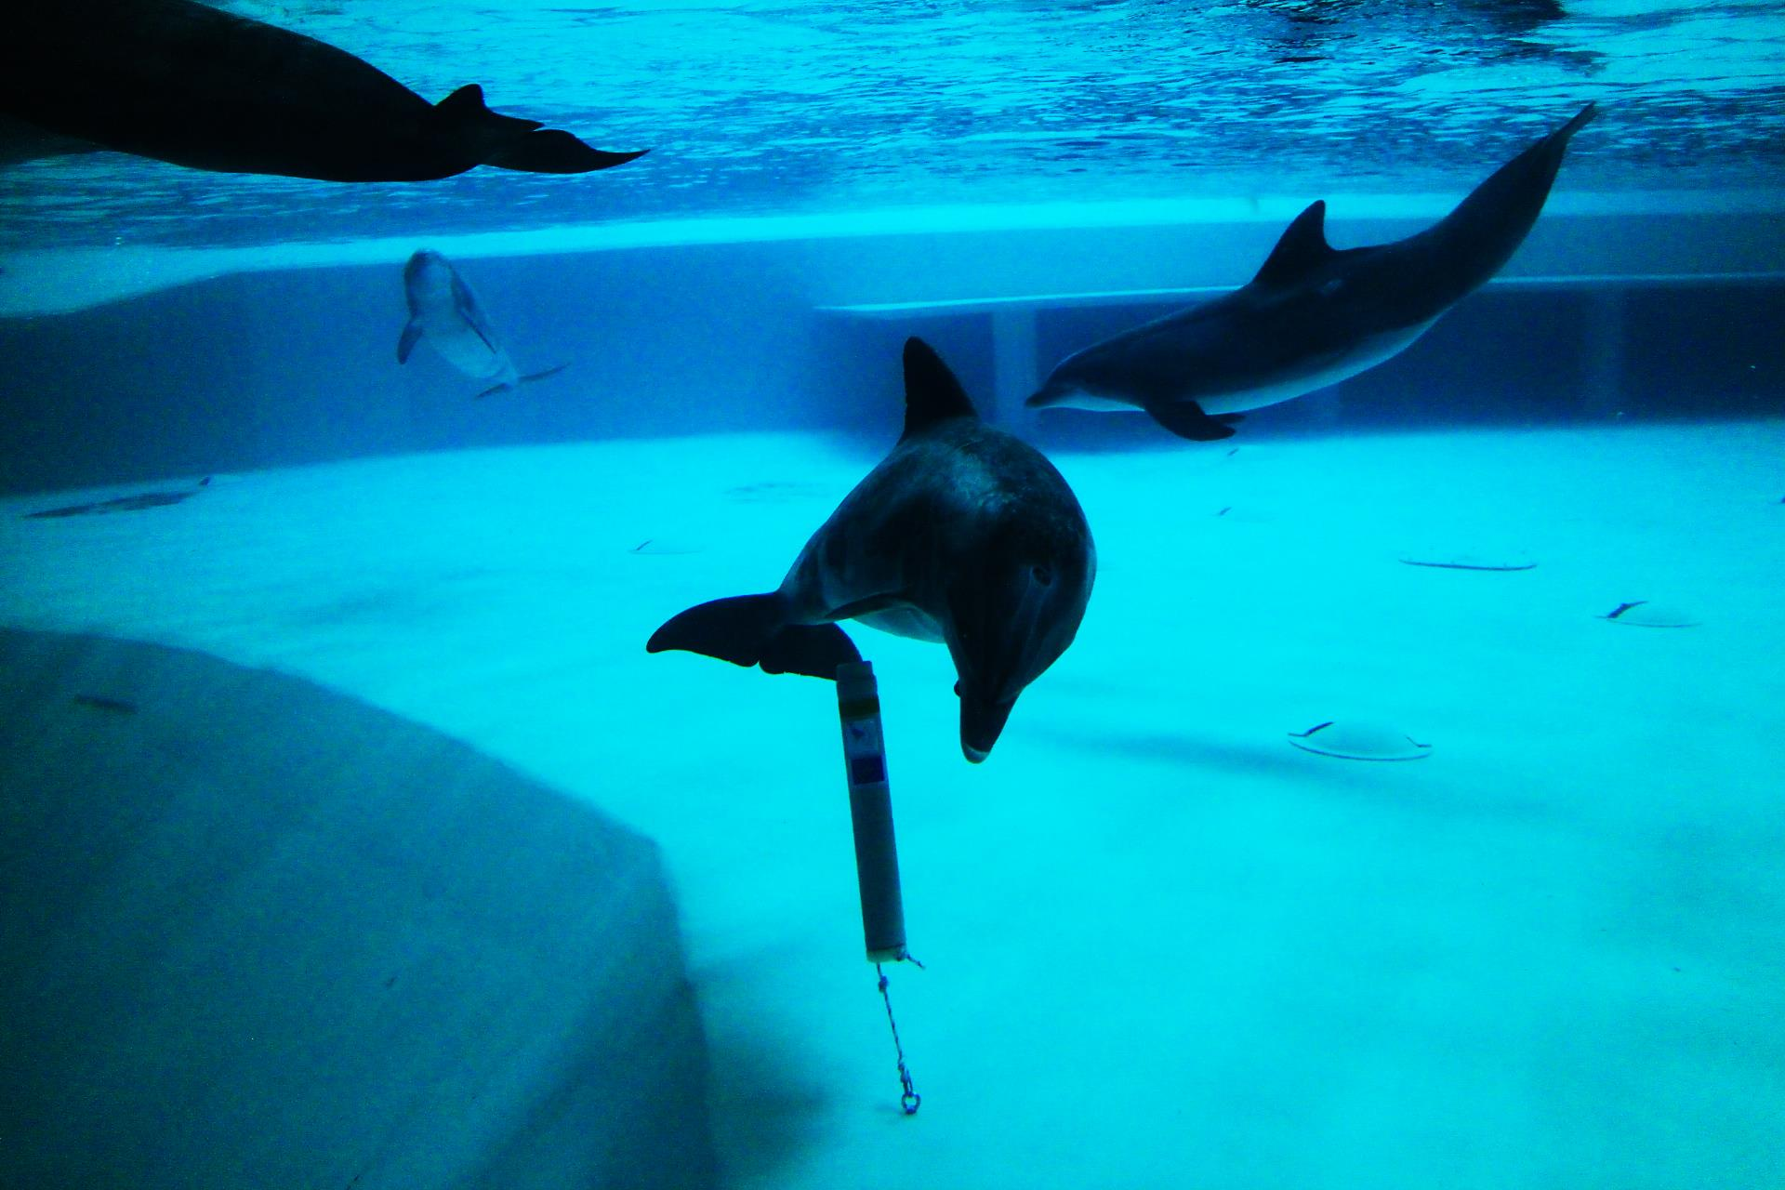

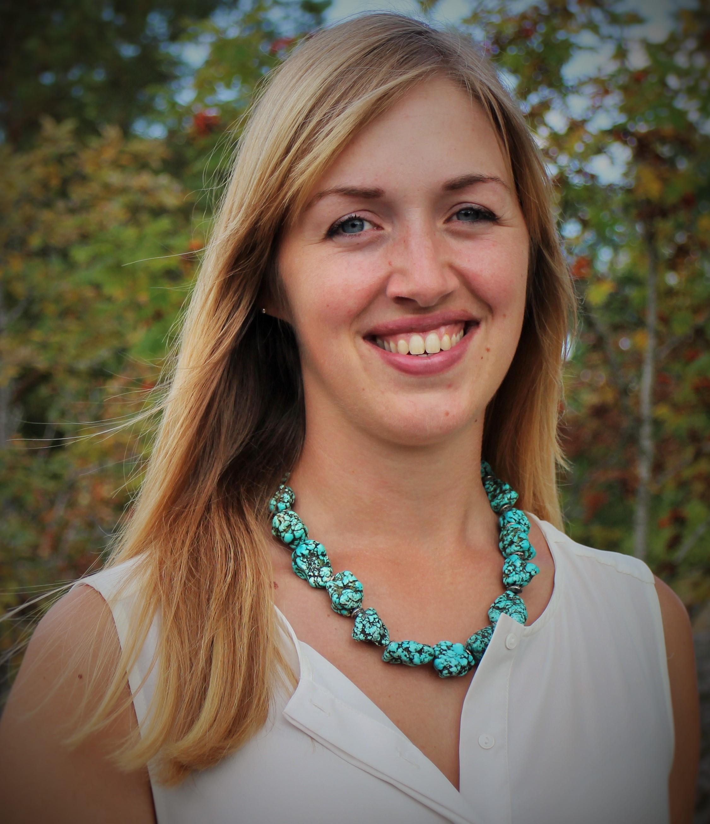

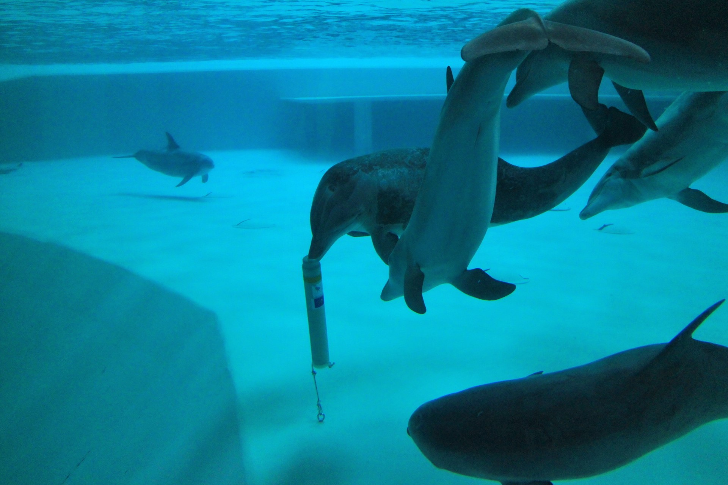
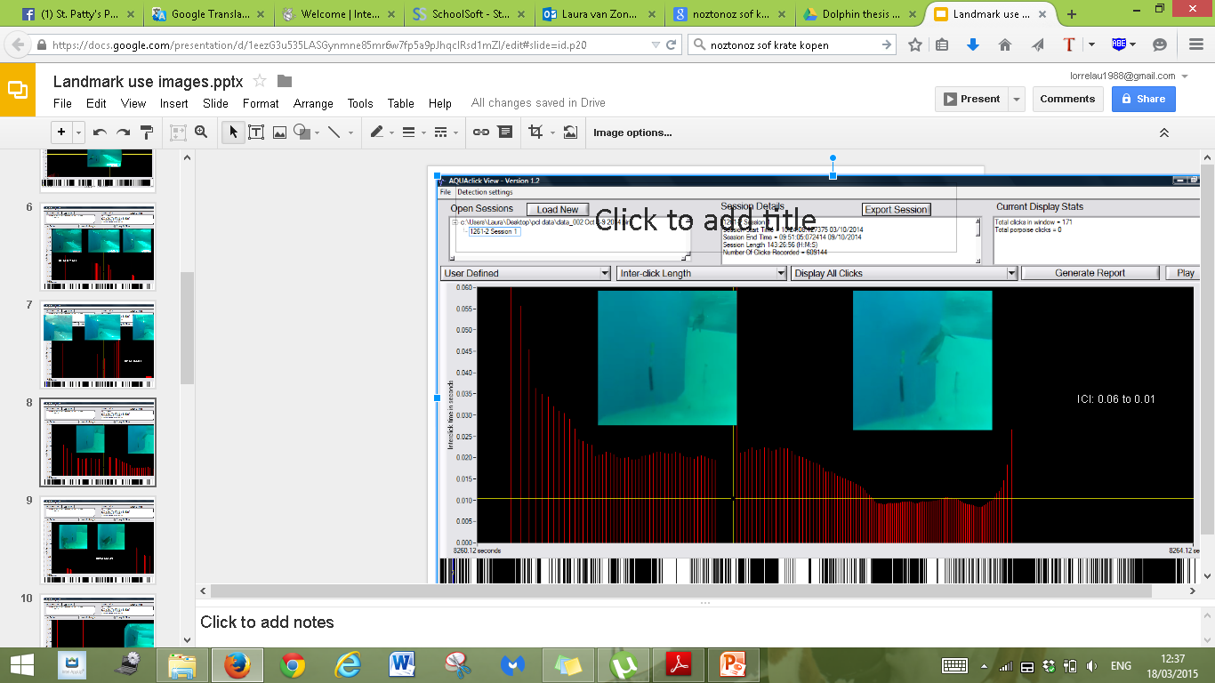
The importance of acoustic enrichment in bottlenose dolphins (Tursiops truncatus) in human care.
Laura van Zonneveld & Mats Amundin
Introduction
Objectives
Material&Methods
A dolphin pool is often a very barren environment, with almost no objects in the water column for the dolphins to explore, which can cause sensory understimulation. During this project we provided the dolphin group in Kolmården Wildlife Park in Sweden with click loggers to provide potential acoustic landmarks and sonar targets to explore. The loggers recorded all sonar activity, whilst interactions with the devices as well as the dolphins’ swimming patterns were recorded continuously by two cameras.
Do the dolphins use the click loggers as landmarks?
Is the echolocation activity evenly distributed at night and during day-time?
Is the echolocation activity correlated to light levels?
The click loggers were suspended from the pool floor. Two cameras recorded the behaviour of the dolphins for 12 hours a day. A roof camera documented the swimming patterns and an underwater camera documented the interactions with some of the loggers.
Results
Fig 2. A clear diel pattern is found in echolocation activity, with most clicks recorded between midnight and early morning
Fig.1 Dolphins exploring a newly introduced CPOD.
Conclusions
Fig. 3 A typical diel pattern in echolocation activity (clx / h) during two weeks, one in August/September and one in October. Season and daylight hours do not seem to affect the diel pattern.
Most clicks were recorded between midnight and 6 AM, with peaks reaching over 50,000 clicks/hour per logger.
Echolocation activity dropped throughout the day and reached the lowest point between 6PM and midnight.
During rest, only occasional clicks were recorded, indicating limited use of landmarks.
Season does not seem to have an effect on the diel patterns.
More time was spent and more clicks were recorded in the deeper area of the pool.
The number of logged clicks dropped over 3 weeks after which it leveled at an average of around 5000 clicks/hour per day and logger.
Fig. 4 Inter-click interval (ICI) in a 3 sec long click train during an approach towards a PCL. The ICI is decreasing during the approach indicating a “lock-on-target” – the dolphins waited for the echo to arrive before emitting the next click.
Contact information: Linköping University: IFM Department, www.ifm.liu.se, lauva117.student@liu.se, laura.vanzonneveld@aol.com, 18th of March 2015

Slide 2
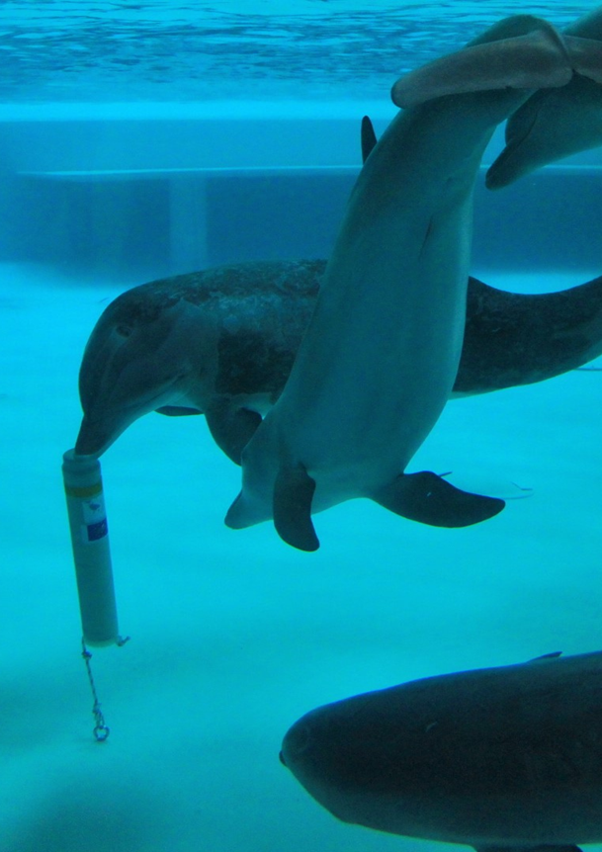



The importance of acoustic enrichment in bottlenose
dolphins (Tursiops truncatus) in human care.
Laura van Zonneveld & Mats Amundin
Introduction
A dolphin pool is often a very barren environment, with almost no objects in the water column for the dolphins to explore, which can cause sensory understimulation. During this project we provided the dolphin group in Kolmården Wildlife Park in Sweden with click loggers to provide potential acoustic landmarks and sonar targets to explore. The loggers recorded all sonar activity, whilst interactions with the devices as well as the dolphins’ swimming patterns were recorded continuously by two cameras.
Objectives
Do the dolphins use the click loggers as landmarks?
Is the echolocation activity evenly distributed at night and during day-time?
Is the echolocation activity correlated to light levels?
recorded between midnight and 6 AM, with peaks reaching over 50,000 clicks/hour per logger.
Echolocation activity dropped throughout the day and reached the lowest point between 6PM and midnight.
During rest, only occasional clicks were recorded, indicating limited use of landmarks.
Season does not seem to have an effect on the diel patterns.
More time was spent and more clicks were recorded in the deeper area of the pool.
The number of logged clicks dropped over 3 weeks after which it leveled at an average of around 5000 clicks/hour per day and logger.
Materials and Methods
The click loggers were suspended from the pool floor. Two cameras recorded the behaviour of the dolphins for 12 hours a day. A roof camera documented the swimming patterns and an underwater camera documented the interactions with some of the loggers.

