Slide 1
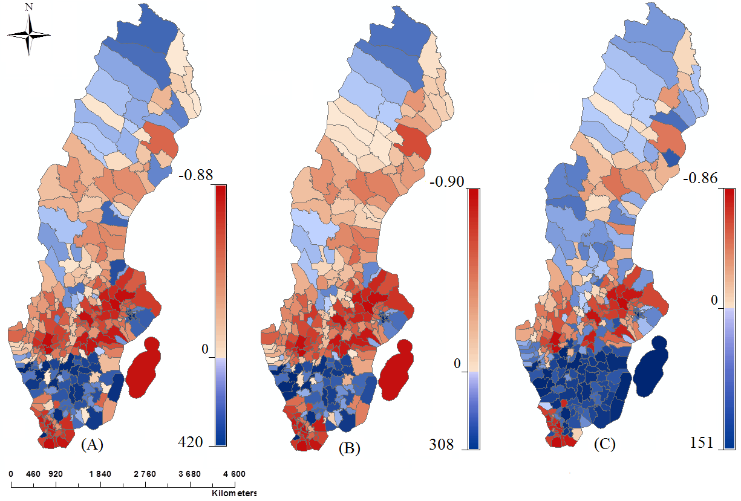
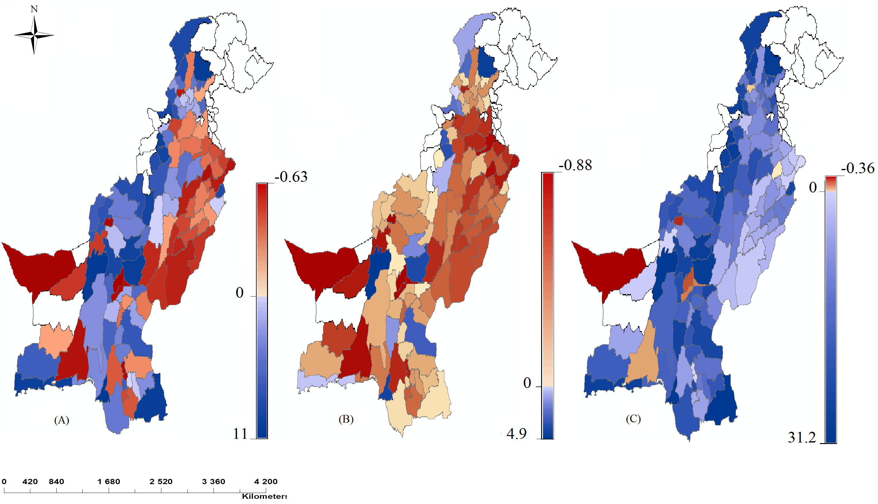
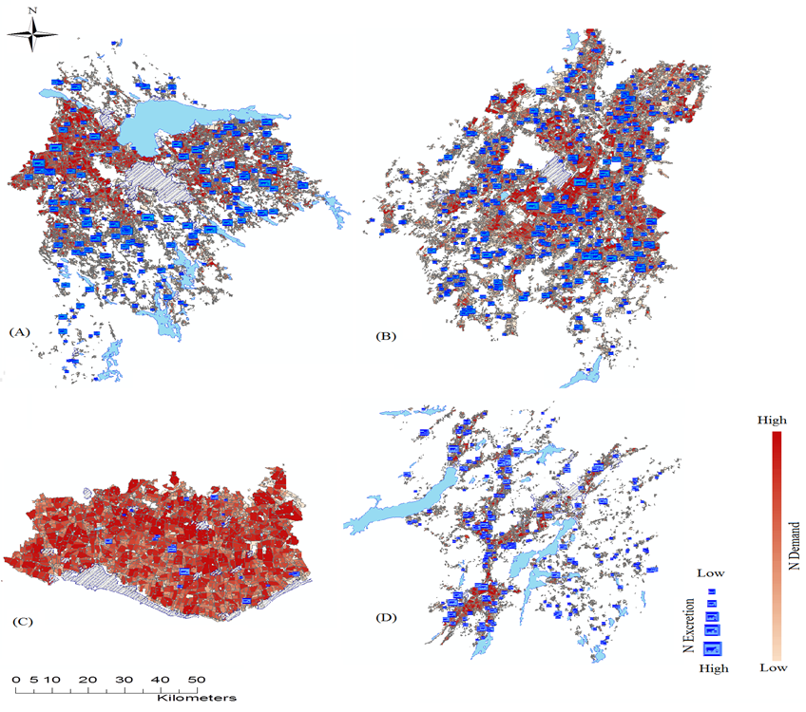
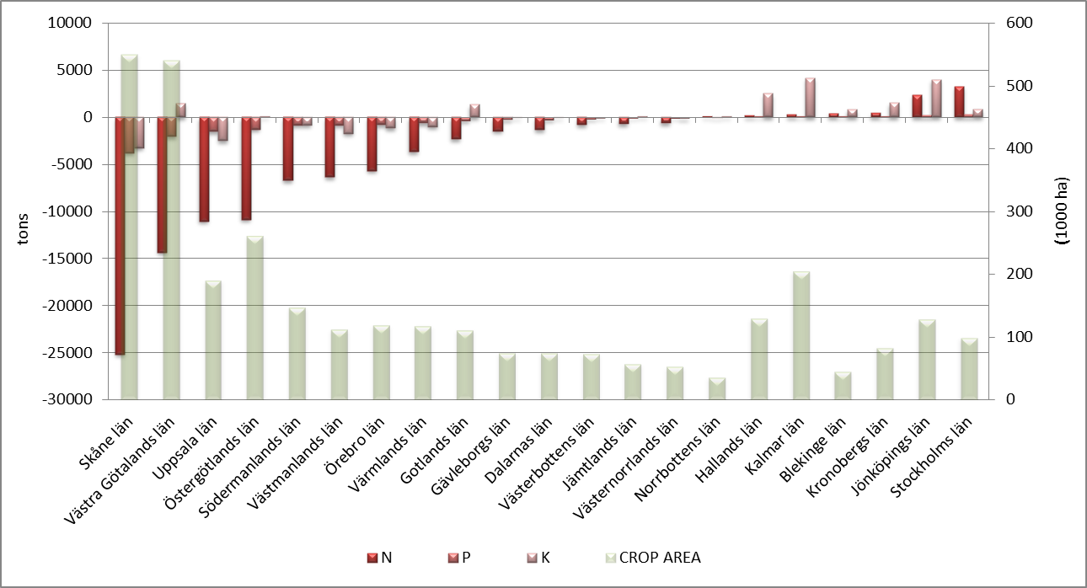
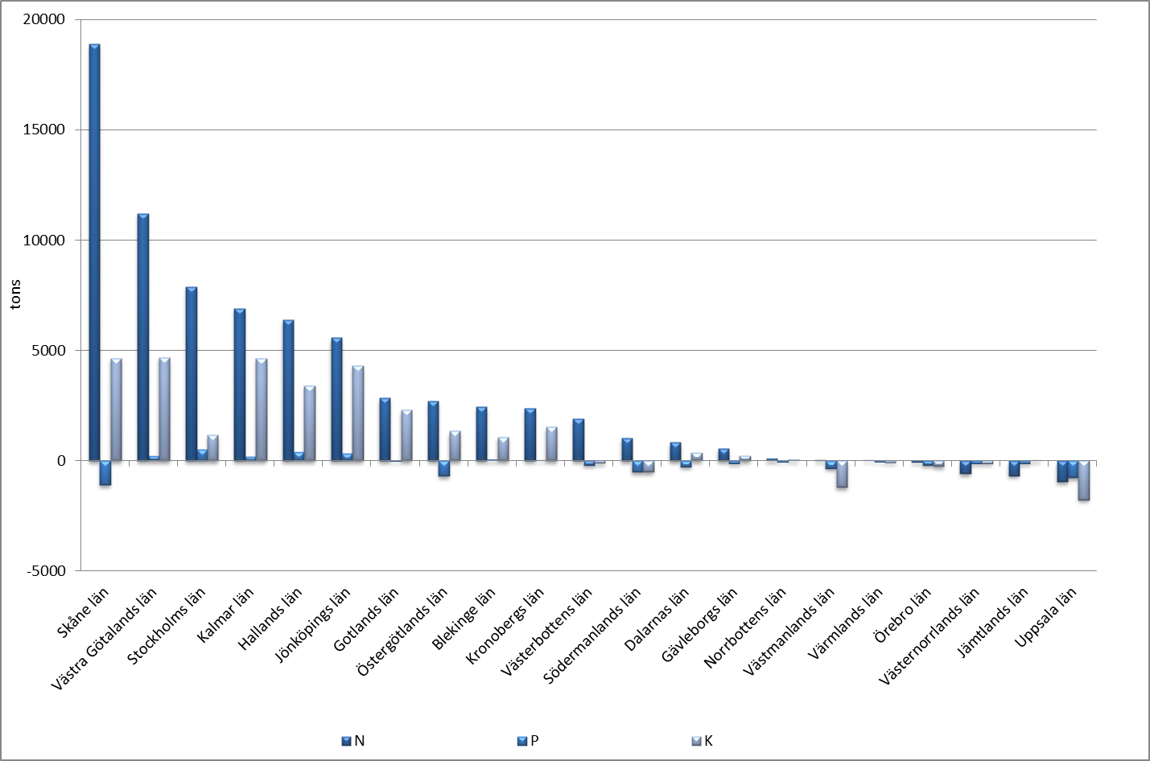
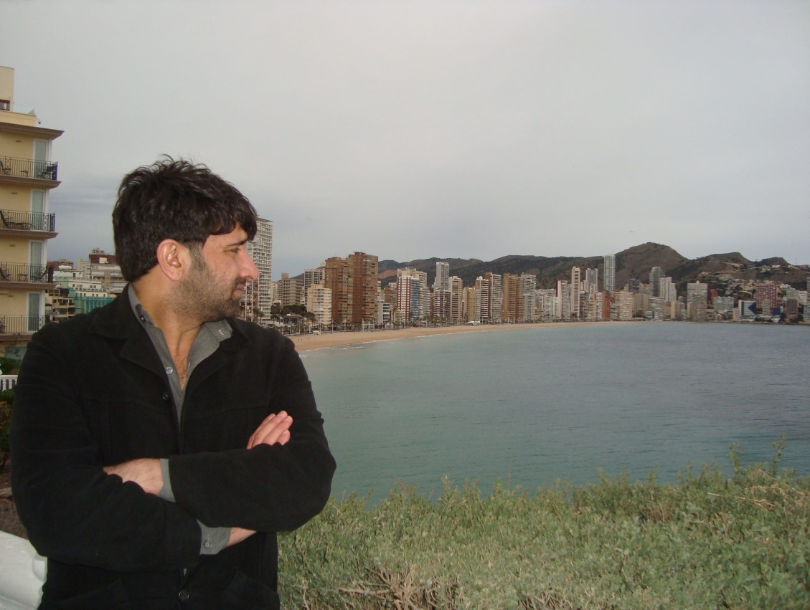
The potential of recycling of nutrients for food production and ecosystem protection: A case study of Sweden and Pakistan
Usman Akram and Uno Wennergren
Theoretical Biology, IFM Linköping University, Sweden
Introduction
Nutrients are important for human survival. The unavailability of nutrients in food is responsible for about 90% of deaths in the world compared to 10% resulting from war conflicts.
Furthermore, about 8.5 to 9.5 million tons of mined fossil phosphorous are lost into the oceans every year thereby causing eutrophication (Rockström et al., 2009).
In this study, the balance of nutrients at different spatial scales is investigated.
Our analysis suggest that unbalancing the production/excretion cycles at the local (regional) level affect the nutrient balances at the global (country) level.
Materials and methods
Sweden and Pakistan was analysed.
Combining spatial data on crops areas, livestock and human population from data bases of boards of Agriculture and boards of Statistic.
Collecting nutrient demand of crops and excretions by humans and livestock from literature. See tables
Calculating:
Nutrients Balance = nutrient in excrements (of human and livestock) - Nutrient demand by crops
Using Microsoft Excel, Microsoft Access and Arc map (10.1) in the analysis.
Excretion per animal place per year (kg)
Animals | Pakistan |  |  | Sweden
 | N | P | K | N | P | K
Dairy cows | 49.38 | 8.62 | 40.99 | 117 | 16 | 104
Young dairy stock | 22.68 | 3.96 | 18.82 | 21 | 3 | 28
Demand by crops Sweden (kg/ha)
Crops | Södragotland |  |  | Norragötland |  |  | Svealand |  |  | Norrland
 | N | P | K | N | P | K | N | P | K | N | P | K
Barley (fall) | 110 | 15 | 32 | 110 | 15 | 32 | 110 | 15 | 32 | 110 | 15 | 32
Barley (Spring) | 90 | 15 | 32 | 95 | 15 | 32 | 95 | 15 | 32 | 80 | 15 | 32
Excretion per human per year (kg)
Country | N | P | K
Sweden | 4.6 | 0.55 | 1.3
Pakistan | 2.7 | 0.4 | 1.5
Demand by crops Pakistan (kg/ha)
Crops | Punjab |  |  | KPK/NWFP |  |  | Sindh |  |  | Baluchistan
 | N | P | K | N | P | K | N | P | K | N | P | K
Barley | 86 | 56 | 86 | 86 | 56 | 86 | 86 | 56 | 86 | 86 | 56 | 86
Cotton | 145 | 26 | 50 | - | - | - | 115 | 26 | 42 | - | - | -
Results
The areas of nutrient consumption are different to the areas of excretions. Separation, is evident from farm level up till country level.
In Pakistan; None of the 111 districts where sinks of all three nutrients. Only 16 where sources of P.
In Sweden; none of the 290 municipalities where sinks of all nutrients. Only 87 where sources of P.
The spatial separation of nutrient sinks and sources cause inefficient recycling of nutrients and excessive use of mineral fertilizers.
Figure 2: Distribution of municipalities of Sweden as sources or sinks of nutrients. Blue is the extra percentage of their own demands, while red is percentage shortage in demands. (A) Nitrogen balances (B) Phosphorous balances (C) Potassium balances.
Figure 3: Distribution of districts of Pakistan as sources or sinks of nutrients. Blue is the extra percentage of their own demands, while red is percentage shortage in demands. (A) Nitrogen balances (B) Phosphorous balances (C) Potassium balances.
Figure 1: Agricultural blocks (nitrogen) demands and distribution of animal farms (nitrogen) excretions. (A) Municipality of Linköping (B) Municipality of Falköping (C) Municipality of Trelleborg (D) Municipality of Mark.
Figure 4: County nutrients before the use of mineral fertilizers in 2008 in Sweden.
Figure 5: County nutrients after the use of mineral fertilizers in 2008 in Sweden.
Conclusion
Contact
In Sweden, spatial separation and poor recycling is responsible for wastage of 70 000 tons of nitrogen and 25 000 tons of potassium. Similarly, in Pakistan, there was a wastage of 3.4 million tons of nitrogen and 1 million ton of potassium.
For Pakistan, the extra nutrients cost worth 226 billion rupees, could be used to feed about 4 million hungry people. While, Sweden had lost resources that can be used to feed 90 000 persons into the ecosystem with resulting eutrophication.
Usman Akram
Spatio-Temporal Biology, SPABIO
IFM - Theoretical Biology
Linköping Univeristy Sweden
Email: usmak91@ifm.liu.se TEL: 46760463216

