Slide 1

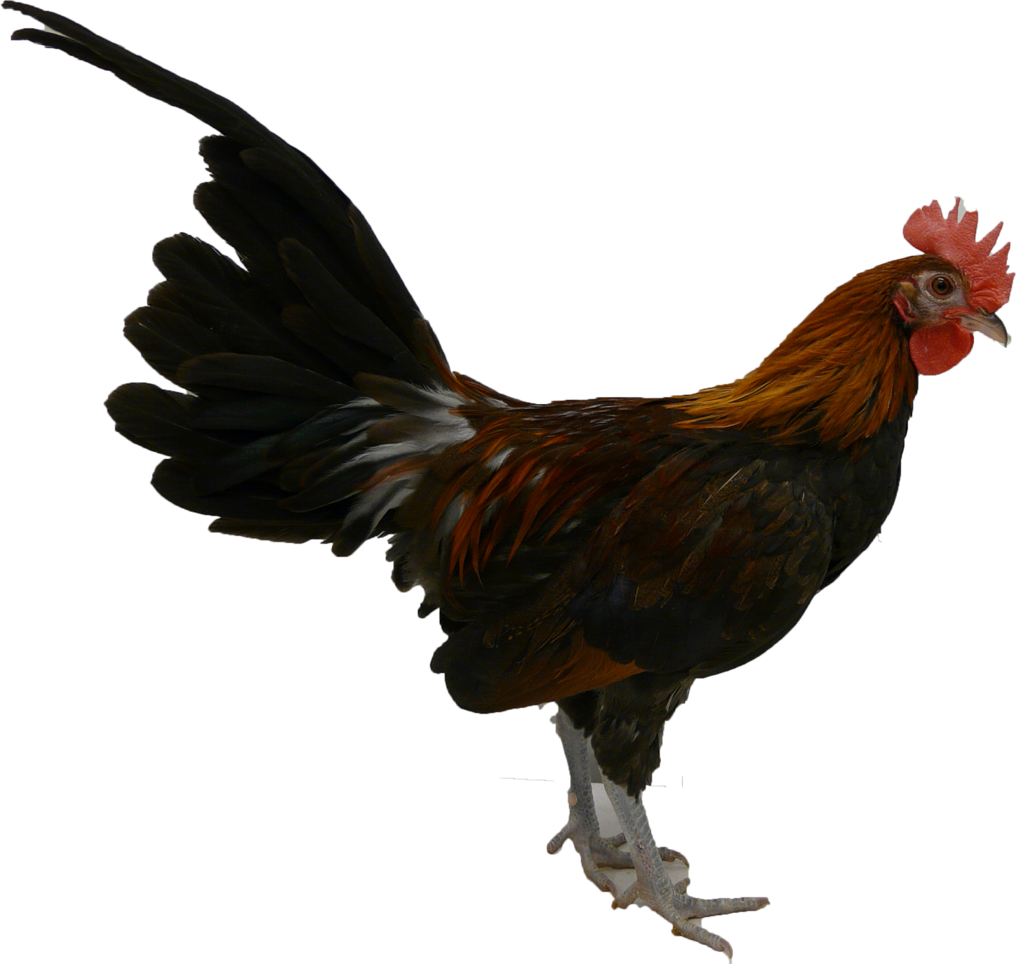

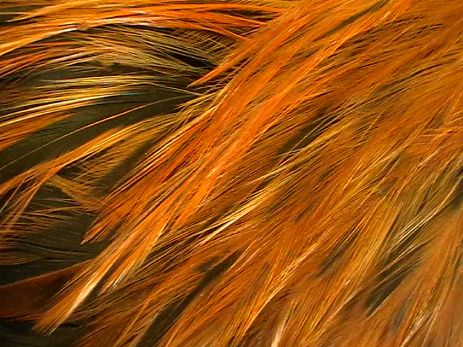
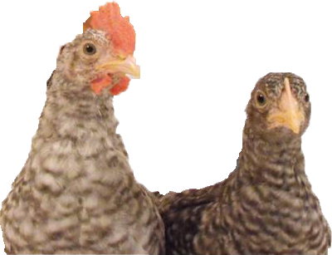
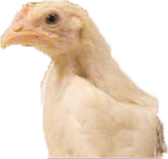
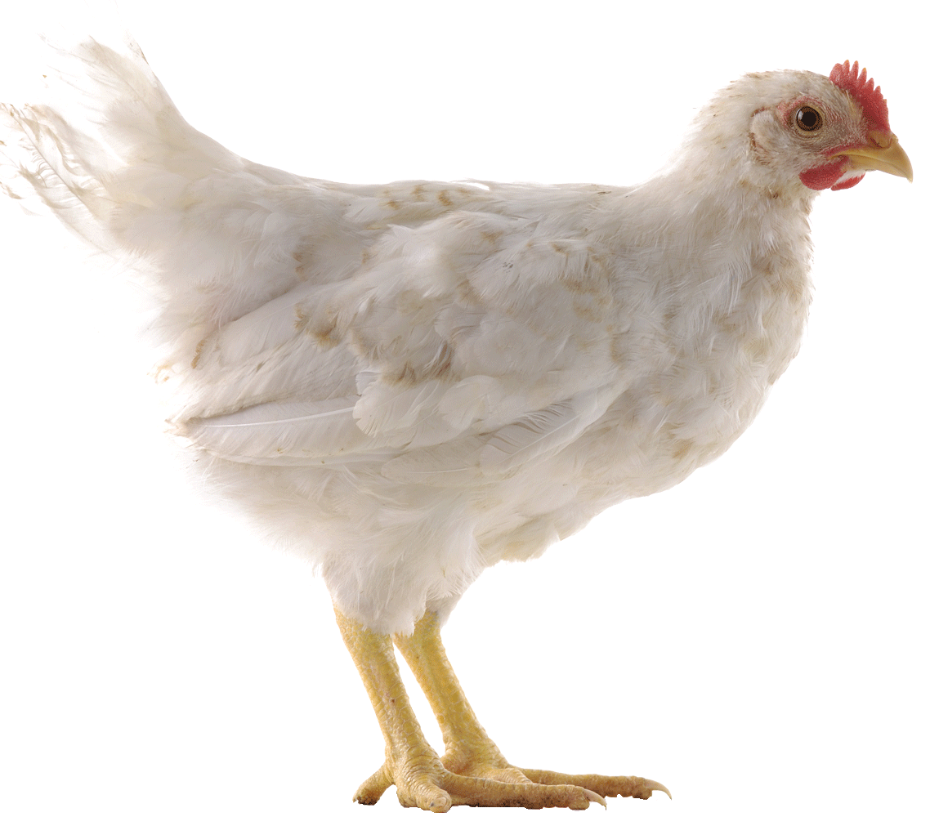
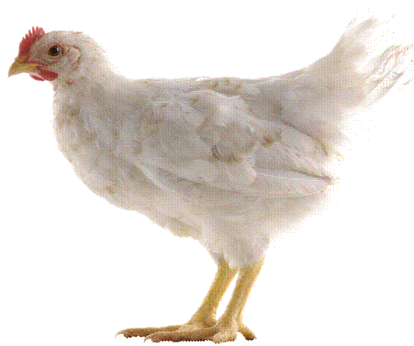
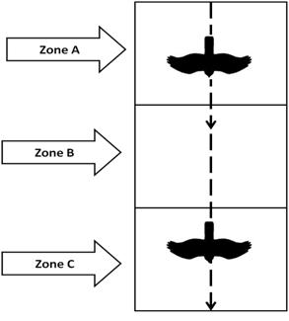
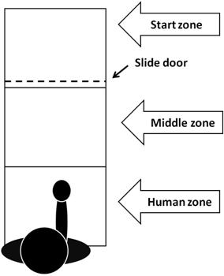


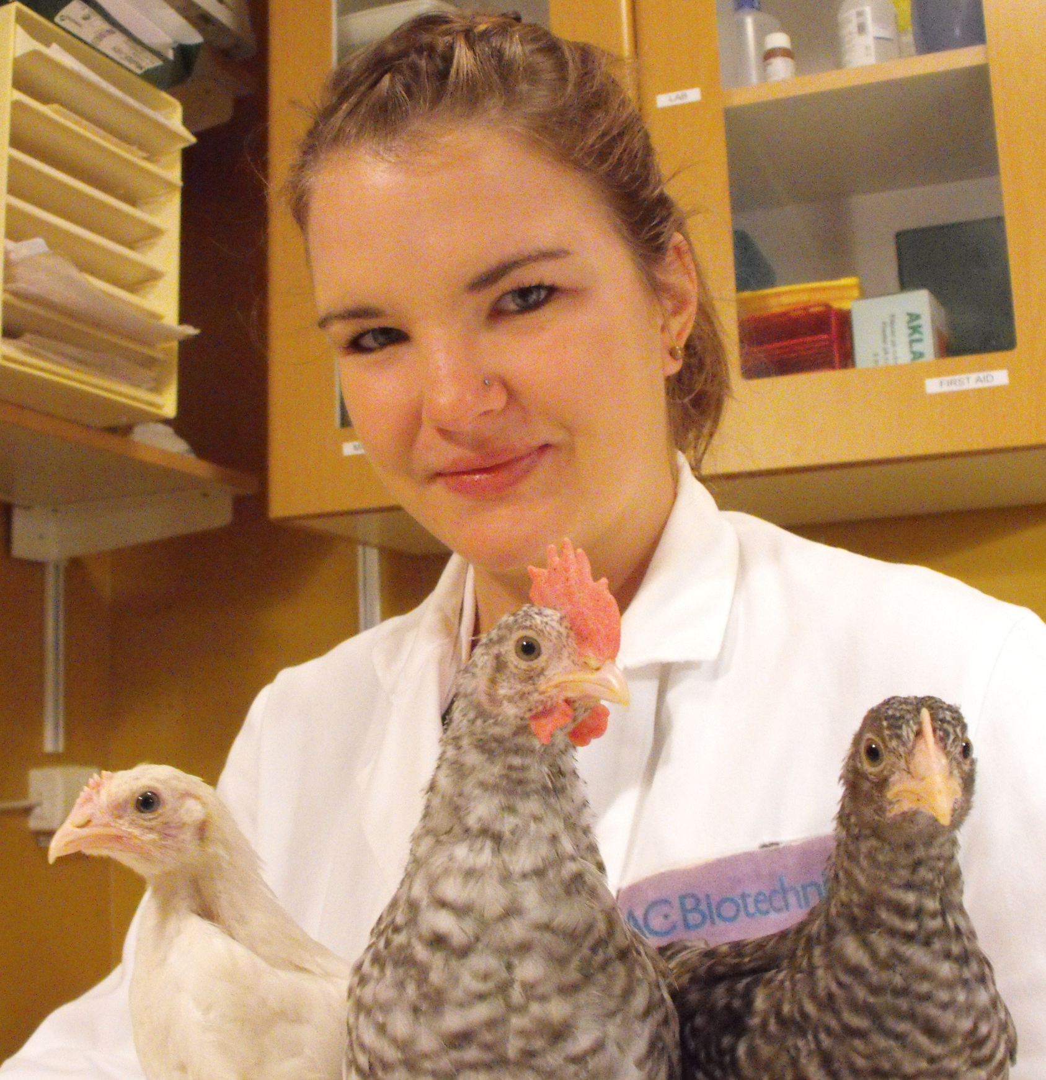
Effects of a mutation in the TSHR- gene on social and fear related behaviours in chickens.
Hypothesis
TSHR –
The domestication gene?
A mutation in the TSHR gene will affect different traits which are considered central for domestication in chickens. The TSHR mutant is believed to express similar behaviours as the domesticated White Leghorn, and the TSHR wildtype the wild breed Red Junglefowl . Four tests will be carried out to measure different aspects of social, exploratory and fear related behaviours.
The thyroid stimulating hormone receptor (TSHR) mutation could be involved in regulating the photoperiodic cycle, affecting development, growth and behaviour in the domestic chicken, all traits with selective advantages during domestication. Therefore TSHR are suggested to be a domestication locus in chickens, where all individuals of domesticated species carry a mutant allele.
Tonic Immobility
Tonic Immobility estimates the birds passive fear response to a human. The stronger fear expressed the longer it will remain in tonic immobility.
Aerial predator
Material
The domesticated breed White Leghorn and the wild breed Red Junglefowl where used as control group. The TSHR individuals consisted of both homozygotes for both of the alternative alleles (Wildtyp and Mutant) and heterozygotes.
Fear of Human
Fear of human tests the birds fear response to a human.
Social Hierarchy
Aerial predator measures
the chicken’s response to a potential predator
Social Hierarchy measures the dominance between two individuals. The first who claimed the limited resource (water) was determined to be the most dominant, combined with observation of antagonistic behaviours.
Food
Results
White Leghorn expressed a more active fear response compared to Red Junglefowl , which was shown in aerial predator and fear of human. Red Junglefowl expressed a more passive fear response. The TSHR birds only showed significant genotype effect for the females in feed from hand in Fear of Human.
Conclusion
The hypothesis that: a mutation in the TSHR gene will affect different traits, central for domestication in chickens could not be accepted nor rejected. For the hypothesis to be accepted the TSHR mutant would have mirrored the domesticated White leghorns behavioural response and the TSHR wild type would possibly have followed the behaviour of the wild ancestor Red Junglefowl. Not all genotypes were represented (no female TSHR mutants) which made it difficult to give an acceptable analysis of all genotypes on the TSHR locus for both sexes.
Johanna Axling’s Master thesis
International Masters Program
Applied Ethology and Animal Biology 2011
Supervisor: Per Jensen

