Slide 1
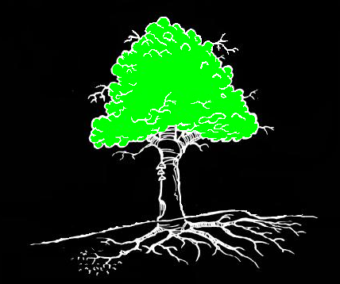
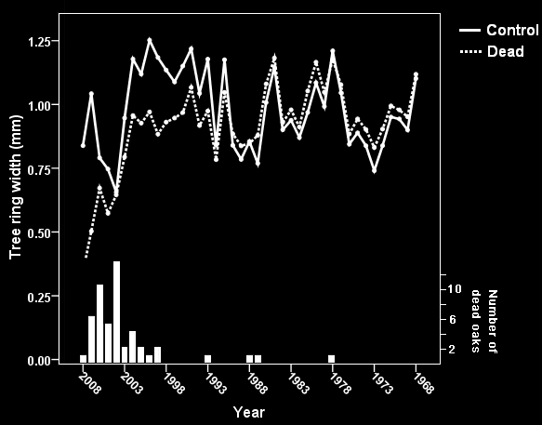
Oak Mortality
-influence of weather and environmental variables
Final thesis. Master’s programme in Ecology and the Environment, 2009. Marie Andersson. Supervisor: Karl-Olof Bergman.
BACKGROUND
- Severe oak (Quercus spp.) declines have been
recorded in many parts of Europe.
- The causes of the declines are still poorly
understood.
AIM
- Clarifying the temporal process of oak
declines.
- Identifying environmental variables
that increase the risk of oak mortality.
METHODS
- Growth pattern of 72 dead and 72 living
oaks were analyzed using core samples.
- Tree and environmental variables were
analyzed for 216 dead and 335 living oaks.
Summer droughts
Air pollutants
Insect defoliations
Winter and
spring frosts
NH₄⁺
Nitrogen compounds
Pathogenic fungi
Bacteria and viruses
Factors that have been shown to influence the oak’s vigour.
CONCLUSIONS
Oak mortality is caused by a combination of long- and short-term stresses.
Equal need of studying present as well as past factors influencing the oak’s vigour.
RESULTS & DISCUSSION
Highest mortality:
-during the last decade
Drought in 1992:
-triggering factor
Insect defoliation in 2003-2004:
-further reduced vigour
Environmental variables:
-weak influence
2003-2004
1992
Growth chronologies of dead and control oaks.
Bars represent the number of dead oaks per year.

