Slide 1
Acknowledgements
I would like to thank my supervisor
Dr. Karl-Olof Bergman for his guidance and support throughout this thesis. I would also like to thank Professor Per Milberg for his statistical support and assistance. Furthermore, I am grateful to Thure Gabriel Bielke, as well as the county administrative board of Östergötland, for giving me permission to perform my
study on their land.
Oak mortality in
south-eastern Sweden
-influence of weather and environmental variables
Contact info:
Marie Andersson
Mail: maran677@student.liu.se
Phone: +46(0)709646619
Marie Andersson
Final thesis. Master’s Programme in
Ecology and the Environment, 2009

Slide 2
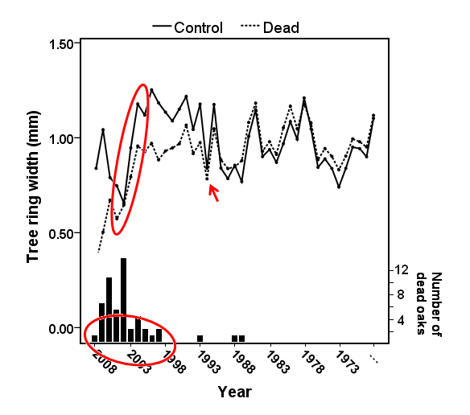
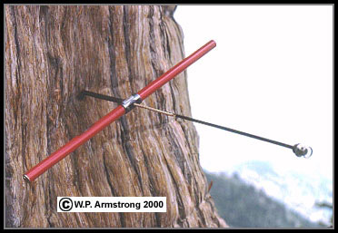
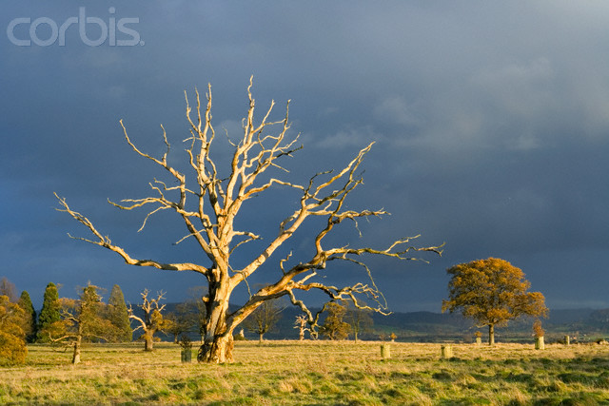
Background
Severe oak (Quercus spp.) declines have been recorded in many parts of Europe during the past three decades. The causes of the declines are still poorly understood, but are belived to involve several biotoc and abiotic factors.
Aim
Clarifying the temporal process of oak declines.
Identifying environmental variables that increase the risk of oak mortality.
Methods
Core samples from 72 dead and 72 living oaks (Quercus robur) were analyzed using dendrochronological methods. Tree and environmental variables were recorded for 216 dead and 335 living oaks, and analyzed using the Chi²-test and the Kolmogorov-Smirnov test.
Results & Discussion
Conclusions
Results from this study support the concept of attributing oak mortality to a combination of long- and short-term stresses.
In order to fully understand the causes of oak mortality, there is an equal need of studying present as well as past factors influencing the oaks vigour.
Although the impact of environmental variables was rather low in this study, site specific properties should not be considered unessential when analysing the causes of oak mortality.
Growth chronologies of dead and control oaks. Bars represent the number of dead trees each year.
Most trees died during the last decade, with two pronounced peaks in 2004 and 2006.
The triggering factor of the oak decline was a drought taking place in 1992.
An insect defoliation further reduced the vigor of the trees in 2003-2004.
Environmental variables had a weak influence on oak mortality.

