Slide 1
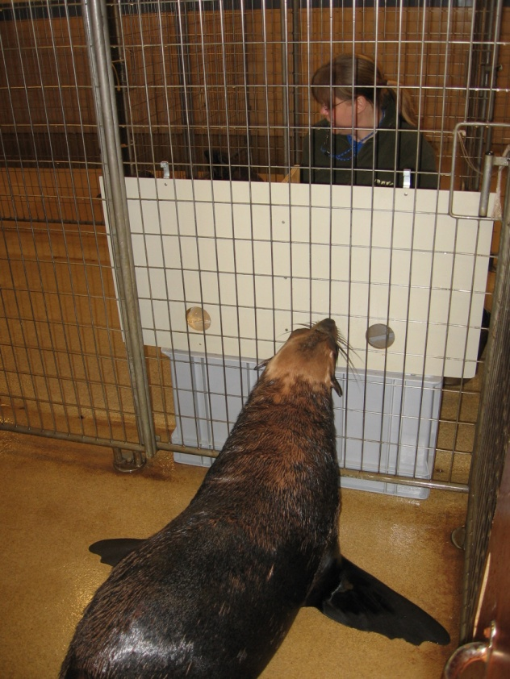
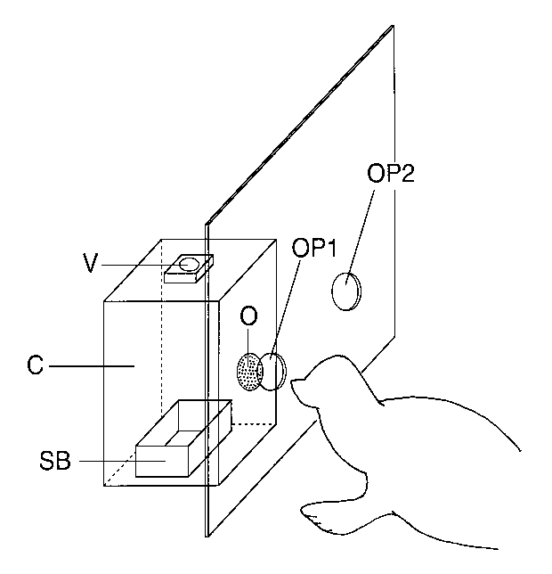
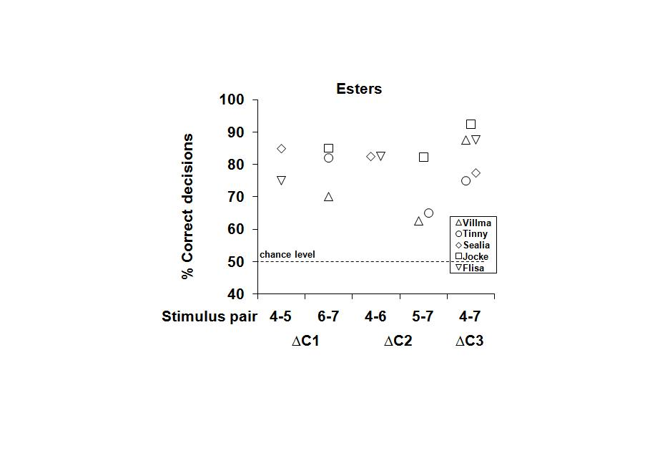
Olfactory discrimination in South African fur seals (Arctocephalus pusillus)
of aliphatic aldehydes, carboxylic acids and acetic esters
Sandra Selin
Final thesis. International Master Programme Applied Biology 2008 Supervisor: Prof. Matthias Laska
Aims:
Determine the olfactory discrimination ability of South African fur seals
Assess whether a correlation between discrimination ability and differences in carbon chain length exists
Conclusions:
South African fur seals have a well-developed discrimination ability for the odorant classes investigated
However, discrimination performance did not correlate with the frequency of occurrence of stimuli in their chemical environment
Results:
All seals successfully discriminated between 14 out of 15 stimulus pairs
No correlation between discrimination performance and differences in carbon chain length
None of the odorant classes was significantly better or poorer discriminated
Materials & Methods:
Odorants used differ in frequency of occurrence in the marine environment
Test method: Food-rewarded two-choice instrumental conditioning paradigm
Circled in red: Two cases of failure to
discriminate occurred, and both were within the same odorant pair.

